Slide 1
PHASE II — IMPLEMENTATION & MODEL DEVELOPMENT
Brain Tumor Detection
& Analysis
Using Deep Learning
CNN Detection
MobileNetV2 Classification
U-Net Segmentation
DL Project | Deep Learning Pipeline for Medical Imaging
Notes:
Welcome to the Phase II presentation of our Brain Tumor Detection and Analysis system. In this phase, we have implemented three deep learning models: a CNN for binary tumor detection, MobileNetV2 for multi-class classification, and U-Net for tumor segmentation. Each model addresses a different stage of the diagnostic pipeline.

Slide 2
PHASE II OVERVIEW
What We Built in Phase II
Model 1
Model 2
Model 3
Tumor Detection
Type Classification
Tumor Segmentation
Binary CNN
96% Accuracy
10 Epochs
MobileNetV2
90% Accuracy
15 Epochs
U-Net
Dice ~0.80+
30 Epochs
Advances from Phase I:
✔ Full model implementation ✔ Real dataset training ✔ End-to-end pipeline operational
Notes:
In Phase II, we moved from planning and design to full implementation. We built and trained three distinct deep learning models. Detection achieves 96%, classification reaches 90%, and segmentation achieves a Dice coefficient of 0.80+. The full pipeline now runs end-to-end from MRI/CT input to tumor overlay.

Slide 3
DATA PREPROCESSING
Data Preprocessing Pipeline
Input
Images
Resize
& Normalize
Augmentation
Mask
Processing
Ready
Dataset
MRI / CT
Grayscale & RGB
128×128
224×224 · /255
Rotate · Zoom
Flip · Shear
Binary Threshold
0 / 255
Train / Val
Split
Grayscale Handling
Detection model uses grayscale MRI; Classification uses 3-channel RGB
Class Imbalance
Addressed via balanced sampling and augmentation
Segmentation Masks
Binary threshold applied; resized to match U-Net output
Notes:
We preprocessed images differently for each model. Detection uses 128×128 grayscale, classification uses 224×224 RGB for MobileNetV2 compatibility. Augmentation (rotation, zoom, horizontal flip) helped generalize models. For U-Net, binary mask thresholding was applied to ensure clean ground-truth labels.

Slide 4
MODEL ARCHITECTURE
Three-Model Architecture
MODEL 1 — CNN
MODEL 2 — MobileNetV2
MODEL 3 — U-Net
Tumor Detection
Classification (Transfer Learning)
Segmentation
Input (128×128×1)
Input (224×224×3)
Encoder
Decoder
Conv+BN+ReLU
UpSample↑
Conv2D + ReLU
MobileNetV2 Base
MaxPooling2D
MaxPool↓
Conv+Skip
(Pretrained · Frozen)
Conv2D + ReLU
Conv+BN+ReLU
UpSample↑
GlobalAvgPool2D
MaxPooling2D
MaxPool↓
Conv+1×1
Dense 128 + ReLU
Flatten → Dense
Bottleneck
Dropout (0.5)
Dropout (0.3)
Dense → Sigmoid
Dense 4 + Softmax
← Skip Connections →
Notes:
Three distinct architectures address each task. The CNN detector uses sequential Conv layers suitable for binary classification. MobileNetV2 leverages transfer learning from ImageNet weights, making it efficient for multi-class classification. U-Net's encoder-decoder with skip connections is ideal for pixel-wise segmentation, retaining spatial information.

Slide 5
TRAINING PROCESS
Training Configuration
Parameter
CNN Detection
MobileNetV2
U-Net Segmentation
Epochs
10
15
30
Batch Size
433
175
307
Optimizer
Adam
Adam
Adam
Loss Function
Binary CE
Categorical CE
Dice + BCE
Input Size
128×128
224×224
128×128
Output
Sigmoid
Softmax (4)
Sigmoid (mask)
Callbacks Used:
▸ EarlyStopping — monitors val_loss, stops training when no improvement (patience=5)
▸ ReduceLROnPlateau — halves learning rate on plateau (factor=0.5)
▸ CPU-only environment — limited RAM required smaller batch sizes and careful epoch selection
Notes:
Training was done on CPU, which imposed constraints on batch size and epochs. Adam optimizer was used for all three models. The CNN was quick to train at 10 epochs; U-Net required 30 epochs to converge on segmentation masks. EarlyStopping and ReduceLROnPlateau helped prevent overfitting and speed up convergence.

Slide 6
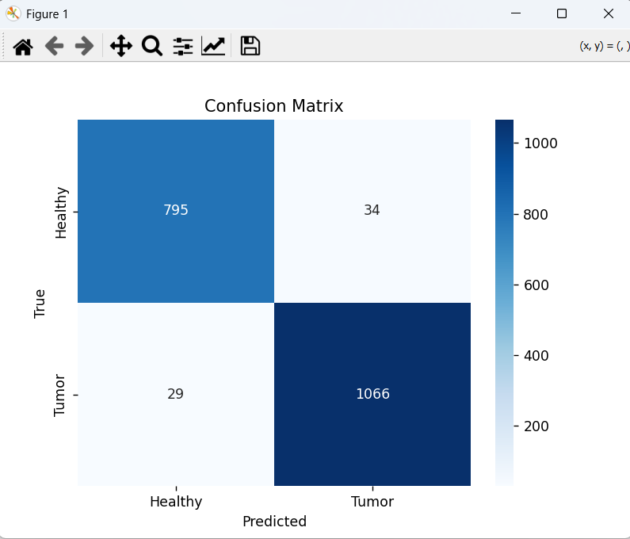
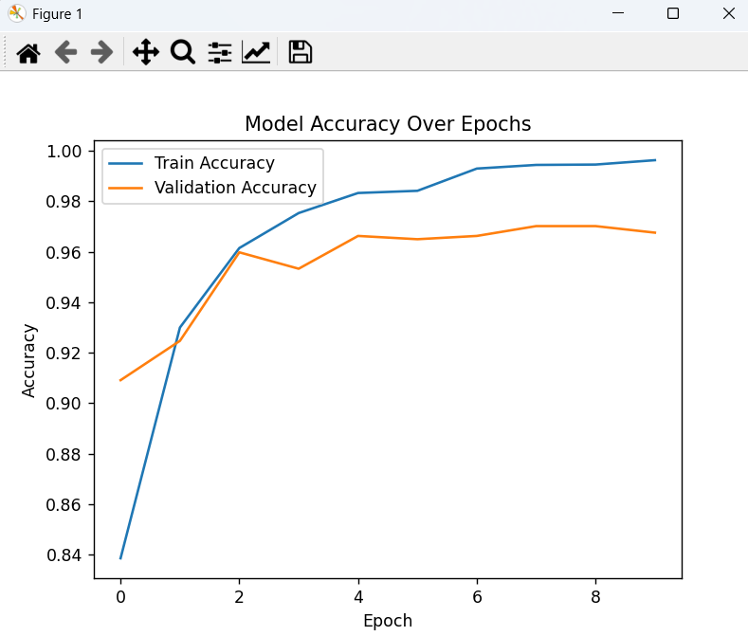
TRAINING RESULTS
Accuracy Graphs
Tumor_classifier
Notes:
The CNN detection model achieved 96% accuracy with well-converging train and validation curves, indicating no significant overfitting. MobileNetV2 achieved 90% overall accuracy across four classes. Glioma and Meningioma had slightly lower F1 scores due to visual similarity. Pituitary and No-Tumor classes were classified most reliably.

Slide 7
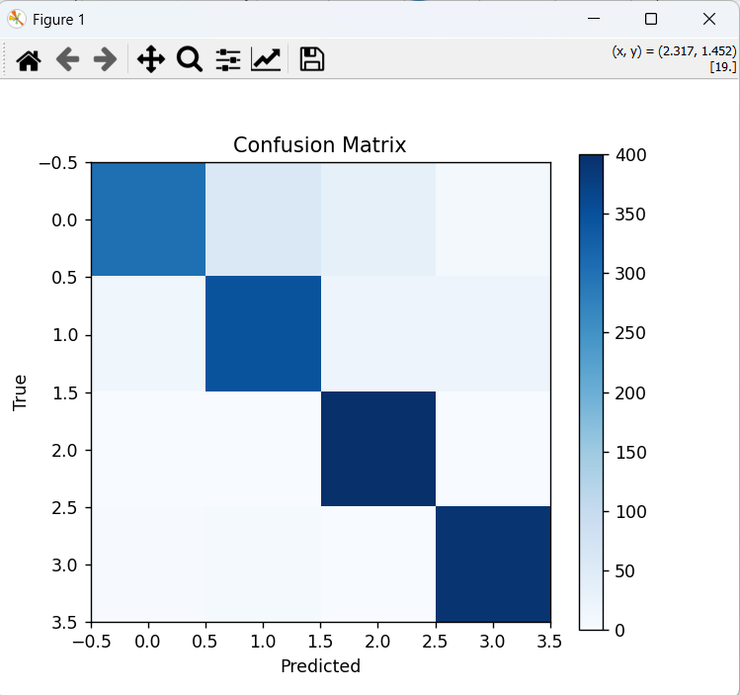
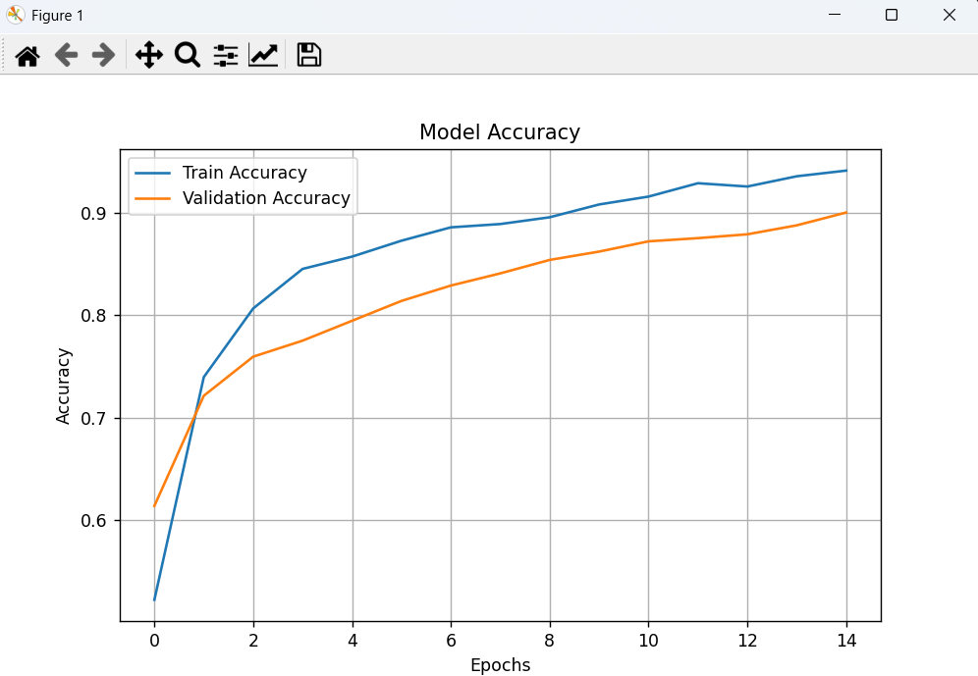
TRAINING RESULTS
Accuracy Graphs
tumor_type_classifier
Notes:
The CNN detection model achieved 96% accuracy with well-converging train and validation curves, indicating no significant overfitting. MobileNetV2 achieved 90% overall accuracy across four classes. Glioma and Meningioma had slightly lower F1 scores due to visual similarity. Pituitary and No-Tumor classes were classified most reliably.

Slide 8
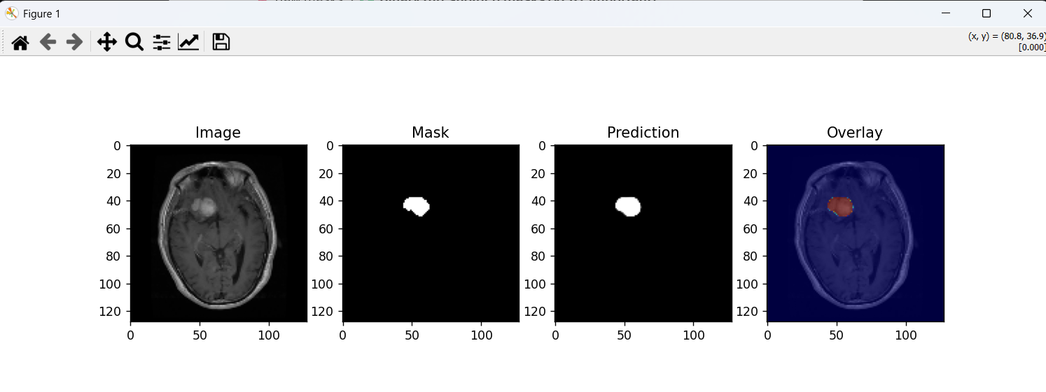
TRAINING RESULTS
Accuracy Graphs
tumor_segmentation
Notes:
The CNN detection model achieved 96% accuracy with well-converging train and validation curves, indicating no significant overfitting. MobileNetV2 achieved 90% overall accuracy across four classes. Glioma and Meningioma had slightly lower F1 scores due to visual similarity. Pituitary and No-Tumor classes were classified most reliably.

Slide 9
SEGMENTATION RESULTS
U-Net Tumor Segmentation
Dice Coefficient — Why We Use It
Dice = 2 × |A ∩ B| / (|A| + |B|)
~0.80+
Accuracy is misleading in segmentation — when the tumor region is small, a model predicting 'all background' gets >95% accuracy but 0% usefulness. Dice measures actual overlap.
Dice
Score
Visual Output Pipeline:
Original MRI
Ground Truth Mask
Predicted Mask
Tumor Overlay
Key Improvements: Batch Normalization · Dropout regularization · Dice + BCE combined loss · Binary mask thresholding at 0.5
Notes:
For segmentation, we used the Dice Coefficient as the primary metric because accuracy is misleading when tumor regions are small. Our U-Net achieved a Dice score of ~0.80+, indicating strong spatial overlap between predicted and actual tumor regions. The output pipeline goes from original MRI to binary mask prediction to tumor overlay visualization.

Slide 10
CHALLENGES
Challenges Faced
💾
🗄️
📊
Large Dataset
.nii File Format
Class Imbalance
BraTS dataset (~13 GB) too large for CPU environment. Required strategic subset selection.
NIfTI medical imaging files require specialized parsing — not standard image formats.
Unequal class distribution skewed training, especially for Meningioma class.
🔁
⚙️
🖥️
Overfitting Risk
Dependency Issues
CPU Constraints
Small dataset + complex models led to overfitting without regularization.
Nibabel, TensorFlow, and image processing library conflicts required resolution.
No GPU access — training was significantly slower, limiting model complexity.
Notes:
We encountered six major challenges: the BraTS segmentation dataset was ~13GB making it impractical for direct use; .nii files required the nibabel library; class imbalance hurt classification performance; overfitting was a risk with limited data; dependency conflicts took time to resolve; and CPU-only training slowed iteration cycles significantly.

Slide 11
SOLUTIONS
How We Solved Each Challenge
💾 Large Dataset
Used a curated subset of BraTS — sufficient for meaningful segmentation training without storage bottleneck.
🗄️ .nii Files
Integrated nibabel library to parse NIfTI slices and convert to standard numpy arrays for training.
📊 Class Imbalance
Applied class-weighted loss and heavy augmentation; also used MobileNetV2 which handles imbalance better.
🔁 Overfitting
Dropout layers, Batch Normalization, EarlyStopping callbacks and ReduceLROnPlateau controlled overfitting.
⚙️ Dependencies
Created isolated environments and pinned library versions for reproducible builds.
🖥️ CPU Constraints
Optimized batch sizes and epochs per model; used transfer learning to reduce training from scratch time.
Notes:
Each challenge had a targeted solution. Transfer learning (MobileNetV2) dramatically reduced training time and improved accuracy despite limited data. Nibabel enabled .nii parsing. Dropout and BatchNorm in U-Net combated overfitting. Augmentation addressed class imbalance. These combined solutions allowed us to achieve strong results within CPU constraints.

Slide 12
FINAL RESULTS
Model Performance Summary
96%
90%
0.80+
Detection Accuracy
Classification Accuracy
Dice Coefficient
CNN Binary Classification
MobileNetV2 Multi-class
U-Net Segmentation
✓ Full end-to-end pipeline operational — from MRI input to segmentation output
Notes:
Our three-model pipeline demonstrates strong performance across all tasks. Detection at 96% enables reliable healthy/tumor binary classification. MobileNetV2 at 90% distinguishes between Glioma, Meningioma, Pituitary, and No-Tumor categories. U-Net's Dice of 0.80+ shows effective spatial localization of tumor regions. The full pipeline is operational end-to-end.

Slide 13
SYSTEM PIPELINE
End-to-End AI Diagnostic Pipeline
INPUT
PREPROCESS
DETECTION
CLASSIFY
SEGMENT
OUTPUT
MRI / CT
Scan
Resize
Normalize
Augment
CNN
Healthy?
Tumor?
MobileNetV2
Glioma /
Meningioma
/ Pituitary
U-Net
Tumor
Region
Annotated
MRI +
Report
Datasets:
Healthy?
Kaggle MRI Dataset (Detection + Classification) · BraTS Subset (Segmentation)
→ Stop
→ Classify
Notes:
The complete pipeline takes an MRI or CT scan as input. After preprocessing, the CNN first determines if a tumor is present. If healthy, the scan is cleared. If a tumor is detected, MobileNetV2 classifies its type. Finally, U-Net segments and overlays the tumor region on the original scan to assist radiologists with spatial localization.

Slide 14
CONCLUSION
Key Achievements
✅ 96% accurate tumor detection CNN deployed on real MRI data
✅ 90% multi-class classification using MobileNetV2 transfer learning
✅ 0.80+ Dice score segmentation with improved U-Net architecture
✅ Complete end-to-end AI diagnostic pipeline fully operational
Future Scope
🌐 Web App Integration ⚡ GPU-accelerated Real-time Analysis 🎯 Higher Accuracy with Transformer models 📋 Clinical Reporting System
Notes:
In summary, Phase II successfully delivered a complete three-model AI pipeline for brain tumor detection and analysis. The system progresses logically from binary detection to multi-class type identification to spatial segmentation. Future work includes GPU optimization, web application deployment, integration of attention-based architectures like Vision Transformers, and clinical reporting automation.

